Slide 1
Segmenting and Clustering Neighbourhoods Gold Coast

Slide 2
Project analysis slide 2
Segmenting and Clustering Suburbs – Gold Coast City
Gold Coast’s population is forecasted to double by 2050 and reach over one-million people
Gold Coast will likely attract many future businesses within the hospitality industry including food and beverages, tourism, lodging and recreation
Project Aim To segment and cluster the suburbs in Gold Coast city based on the most common venues within each suburb.
Results of segmentation and clustering, as well as population data of each suburb will be used to recommend optimal locations for future businesses in the hospitality sector.

Slide 3
Project analysis slide 3
Data Acquisition and Processing
List of Gold Coast suburbs and population data from Wikipedia. 2016 data scraped from https://en.wikipedia.org/wiki/List_of_Gold_Coast_suburbs
Geographical coordinates of suburbs were determined using postcodes as inputs within the GeoCoder package on Python
Suburbs with identical postcodes were combined as one neighbourhood and populations summed together
17 neighbourhoods were identified and visualized using Folium map
Venue data scraped from FourSquare API

Slide 4
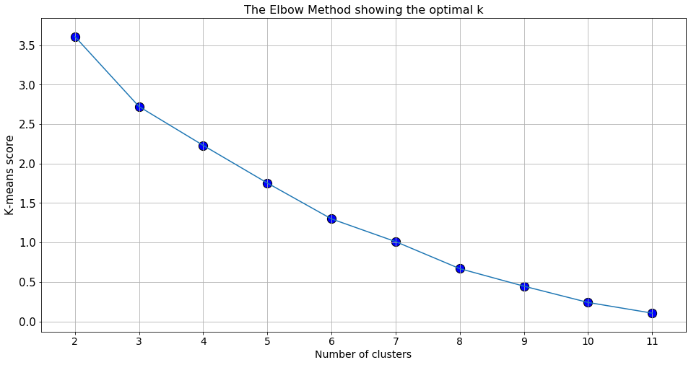
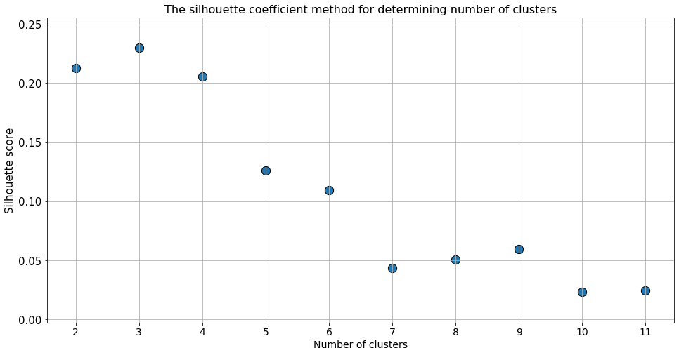
Exploratory Data Analysis
K-means clustering was implemented to cluster the 17 neighbourhoods
Elbow Curve Method and Silhouette Coefficient Method were used to find the optimal number of clusters K
Optimal number of clusters K = 3

Slide 5
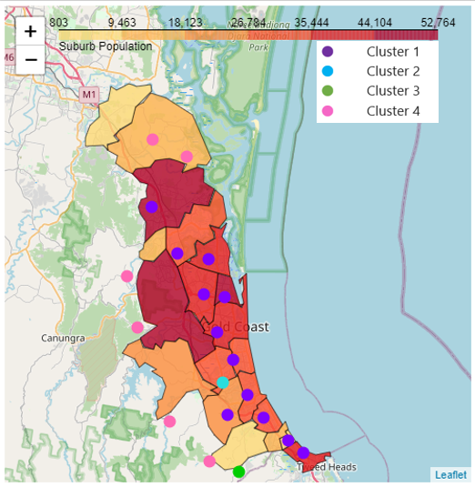
Results
Clustered neighbourhoods separated into four groups
Cluster 1 neighbourhoods are predominantly located along the coastline
Cluster 4 neighbourhoods (no venues) tend to appear further inland
Cluster 1 | Dining/Grocery/Shopping Malls (Hospitality)
Cluster 2 | Outdoor Recreation/Sports Stores
Cluster 3 | Cafes/Clothing Stores
Cluster 4 | No recorded venues

Slide 6
Project analysis slide 3
Conclusion and Future Work
Based on the presented data alone, business owners in the hospitality sector have chosen to setup venues near the coastline – irrespective of population
Future businesses in hospitality may be able to leverage the high population in neighbourhoods labelled as cluster 4 and acquire first mover advantage
Future work will involve assessing other factors that have an effect on the success of a business when it comes to deciding the venue location:
Rental Pricing
Demographics
Household Income

Slide 7
Thank You

